Slide 1
Abstract
Our project applies Multisignature scheme for sending messages in a group.
Multisignature is more secure and eliminates the latest attacks.
Individual signers are identified by the information contained in Multisignature.
It consists of two protocols, Distributed Key Generation(DKG) and Distributed Key Regeneration/Updating(DKRU).
Java is used as the front end and MS Sql Server is used as the back end.

Slide 2
Existing System
In many applications , a group of members are required generate digital signature.
Individual signers remain anonymous , due to the fact that it is computationally hard to derive the individual identities from the group signature.
The computational cost for Signature generation and verification is high.

Slide 3
Proposed System
Individual signers do not remain anonymous , they are traceable.
This ensures accountability, i.e., a participant holds responsible for his contribution in the multisignature.
The computational cost is reduced when compared to other schemes.
We have applied the multisignature in a simple application for sending group messages

Slide 4
System Architecture
Secure Multisignature Generation for Group Communication
Signature
Cryptography
Message Transmission
Signature Generation
Encryption
Multicasting
Signature Verification
Decryption
Unicasting

Slide 5
List of Modules
Signature
  Signature Generation
  Signature Verification
Cryptography
  Encryption
  Decryption
Message Transmission
  Multicasting
  Unicasting

Slide 6
Signature Generation
In this module we are going to generate signatures for the group members.
Thus it has two sub modules,
  Individual Signature Generation
  Multiple Signature Generation.
The Individual signature is generated with Participants private key.
Participants broadcasts the message and the signature to all protocol participants.

Slide 7
Using the ElGamal Algorithm, the individual signature is generated.
Any subset β of t or more members can represent the group and sign an arbitrary message m.

Slide 8
Signature Verification
In this module we are going to verify the group member’s signatures with generated signatures.
On receiving all of the signatures, we performs the functionality of a clerk and use the public key set to authenticate the individual signature .
Participants are disqualified if their individual signatures are found to be invalid.

Slide 9
The remaining honest participants form the set and repeat the individual signature generation. The protocol aborts if it contains less than exact members.

Slide 10
Cryptography
Encryption- The message is encrypted using DES algorithm.
Decryption- The received message is decrypted in the receiver side.

Slide 11
Message Transmission
In this module we are going to transmit our encrypted message to the selected group members.
Then the encrypted message will be decrypted at the other end of group member with the proper verification of the signature
This module has two sub modules they are
  Unicasting and
  Multicasting.

Slide 12
Unicasting sub module is used to transfer our message from one to one recipient.
Multicasting sub module is used to transfer our message from one to many recipient.

Slide 13
Test Cases
Given Input
  User gives the username as entry input
  User gives the password as entry input
  User gives the message for transmission
  System gives the input private key for users
  System gives the input public key for users
  System gives the hash value using the private key

Slide 14
  System gives the Signature from the hash value
  System gives the Encrypted message from the user input message
  System transfers the message signature.

Slide 15
Expected Output
  User receives the encrypted message
  System automatically generates the output signature for verification
  System automatically decrypts the message using Elgamal algorithm
  System automatically shows the sender details
  System automatically shows the decrypted message.

Slide 16
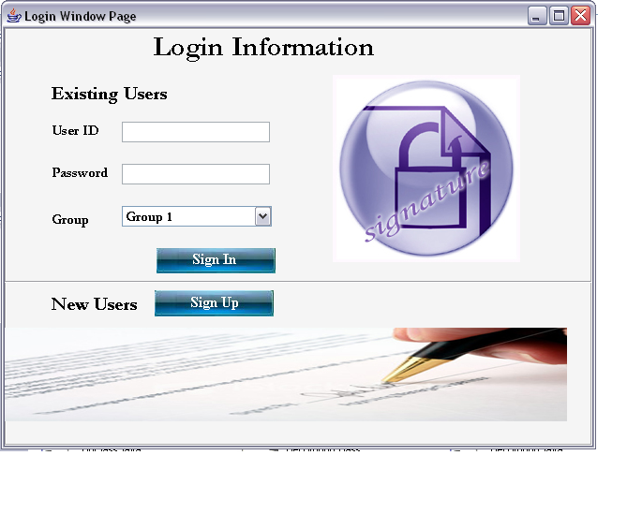
New member signs up

Slide 17
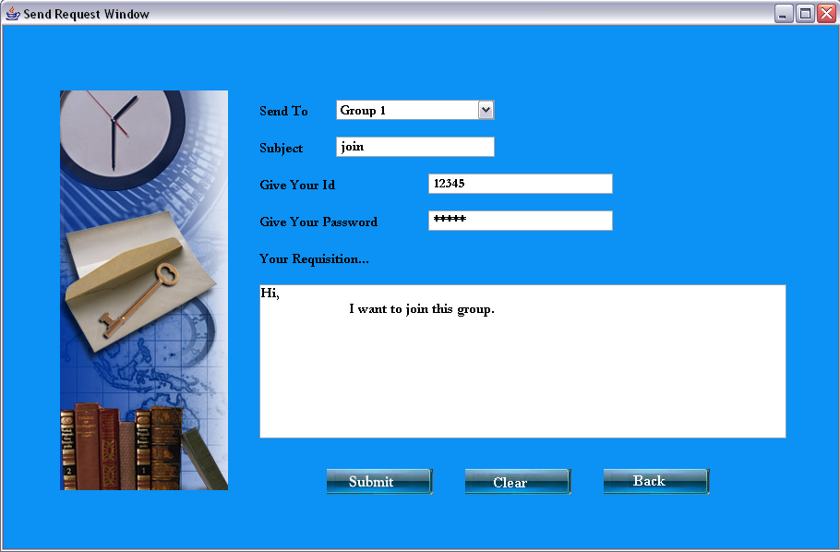
Requisition send to group administrator

Slide 18
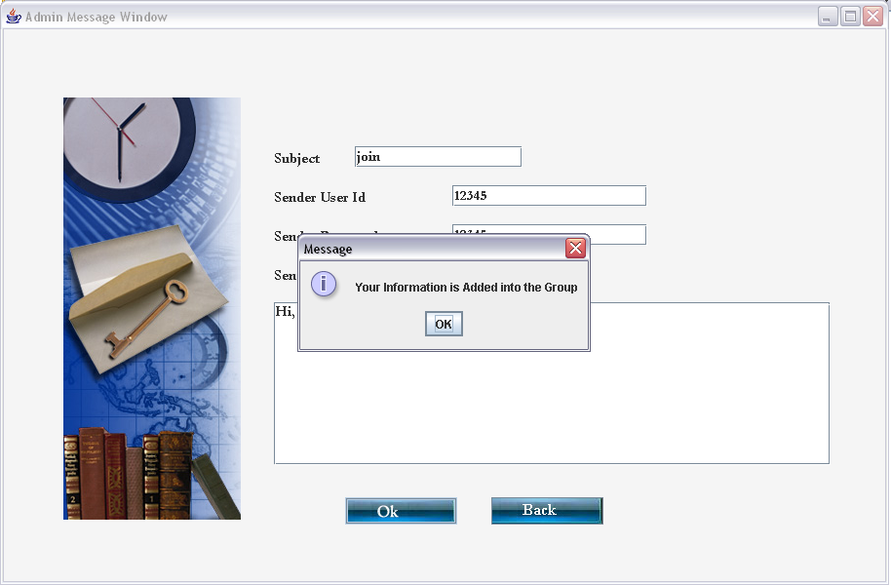
Administrator accepts the requisition

Slide 19
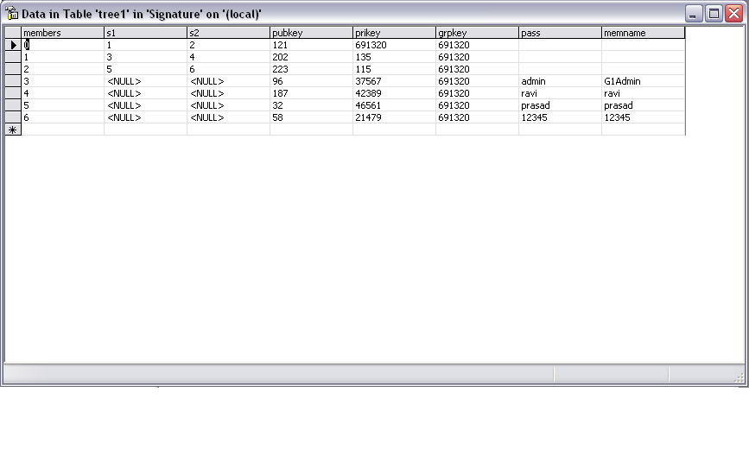
Group key is generated and stored in the database

Slide 20
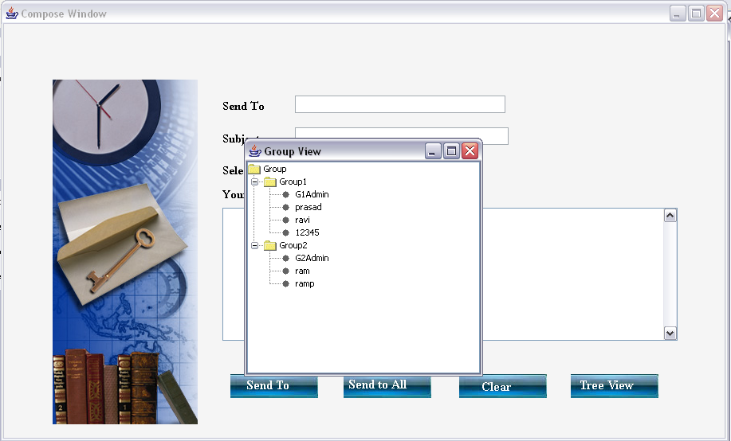
Tree view of the group members

Slide 21
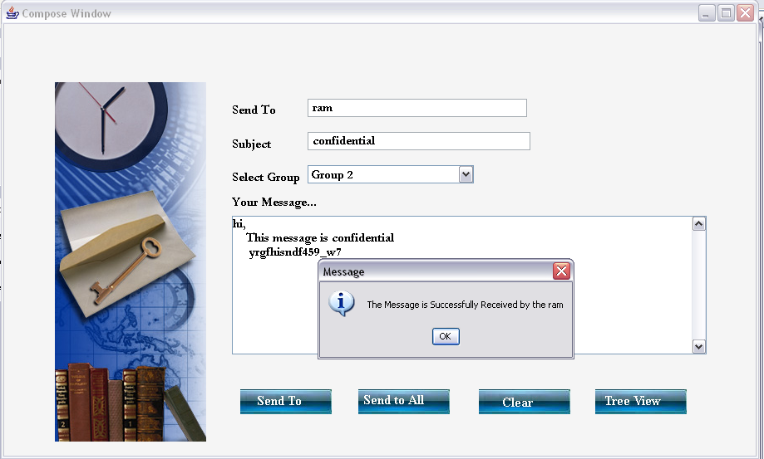
Composing a message

Slide 22
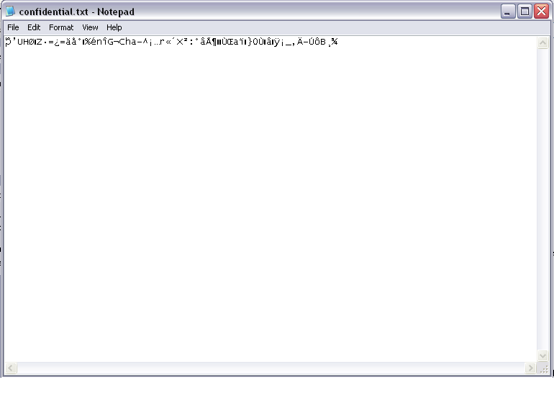
Encrypted message

Slide 23
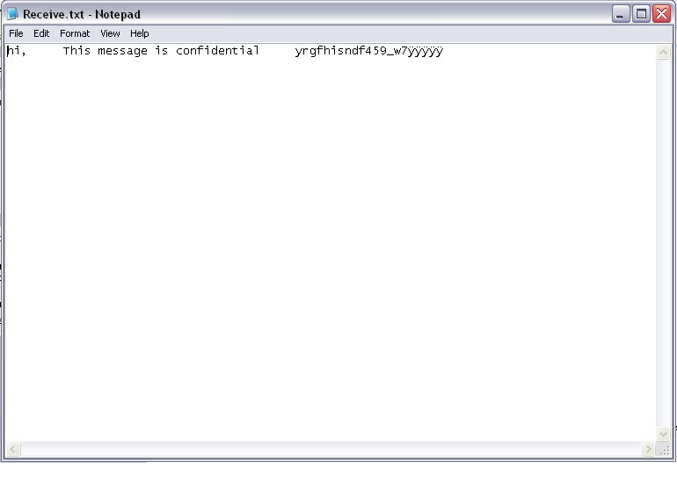
Received message with Multisignature

Slide 24
Future Enhancements
The System can be further improved by introducing a Trusted Third Party(TTP).
The TTP is used to generate the group key.
By introducing the third party the computational cost can be reduced.

Slide 25
Conclusion
A secure MultiSignature Scheme for sending group messages was introduced.
The efficiency of the proposed system outperforms other system.
The Multisignature scheme fulfills all security requirements.
Thus Multisignature scheme can be applied in group communication to improve the efficiency.

Slide 26
Thank You…..

